Slide 1


I’ve been doing some syncing…
Paul Lammertsma
CTO, Pixplicity

Slide 2
Syncing
Why it’s important
Connectivity is always an issue
Battery concerns
When I’ve used it in the past
@lly
Polarsteps

Slide 3
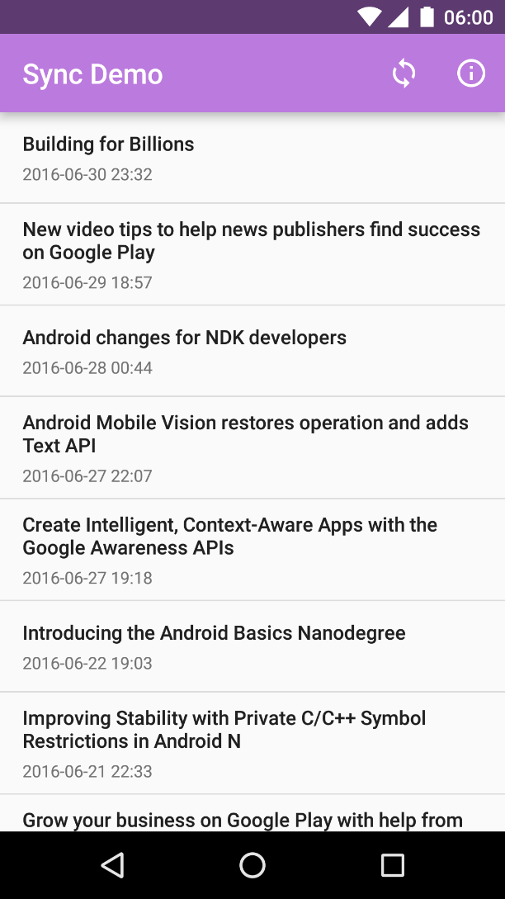
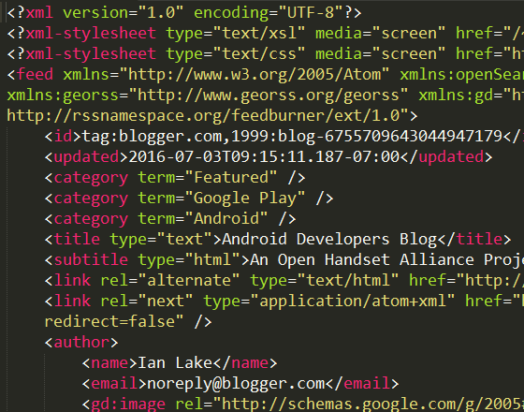

ListView of blog posts
Fetches data when app is opened
UI
Atom XML feed (Android Developers Blog)
Network
ze internet

Slide 4
Bad idea #1a:
No caching
UI
Network
ze internet

Slide 5
Bad idea #1a:
No caching
UI
Bad idea #1b:
No separation of concerns
ActivityA
FragmentX
FragmentY
Network
ze internet

Slide 6
UI
Network
ze internet

Slide 7
UI
ContentResolver.query()
ContentProvider
ContentResolver.insert()
Network
ze internet

Slide 8
CursorLoader
UI
ContentObserver
ContentResolver.query()
ContentProvider
onCreate(): fetch data
ContentResolver.insert()
Network
Bad idea #2a:
Stale data
Bad idea #2b:
Assumes internet connection
ze internet

Slide 9
CursorLoader
UI
ContentObserver
ContentResolver.query()
ContentProvider
Bad idea #3:
Bandwidth/CPU starvation
ContentResolver.insert()
Service
Network
CONNECTIVITY_CHANGE
BroadcastReceiver
ze internet

Slide 10
CursorLoader
UI
ContentObserver
ContentResolver.query()
ContentProvider
ContentResolver.insert()
SyncAdapter
Network
Android Framework
Hey, this would be a great moment to synchronize!
ze internet

Slide 11
Sync Demo

Slide 12
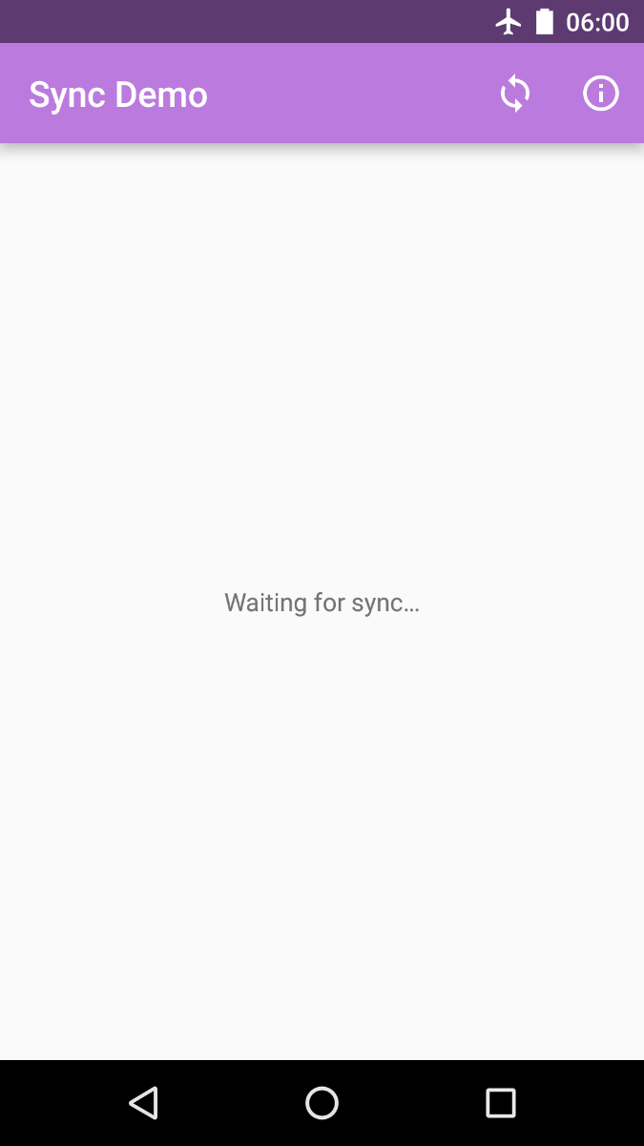


Sync Demo

Slide 13
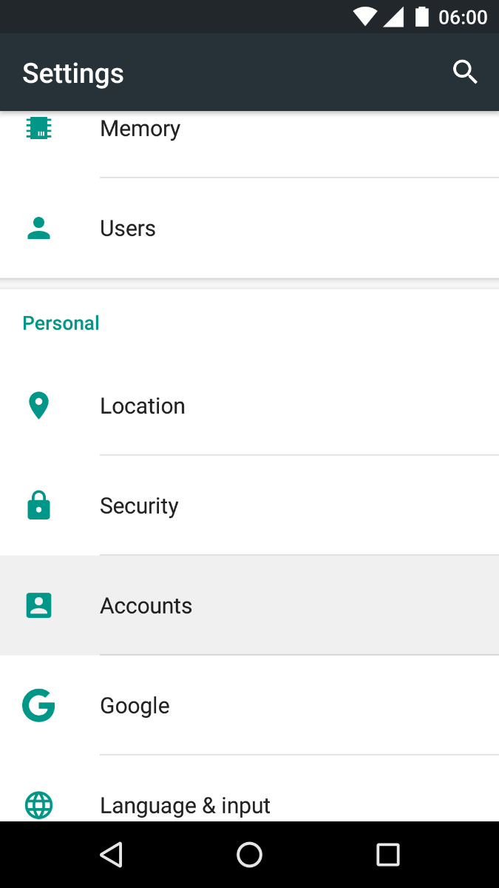
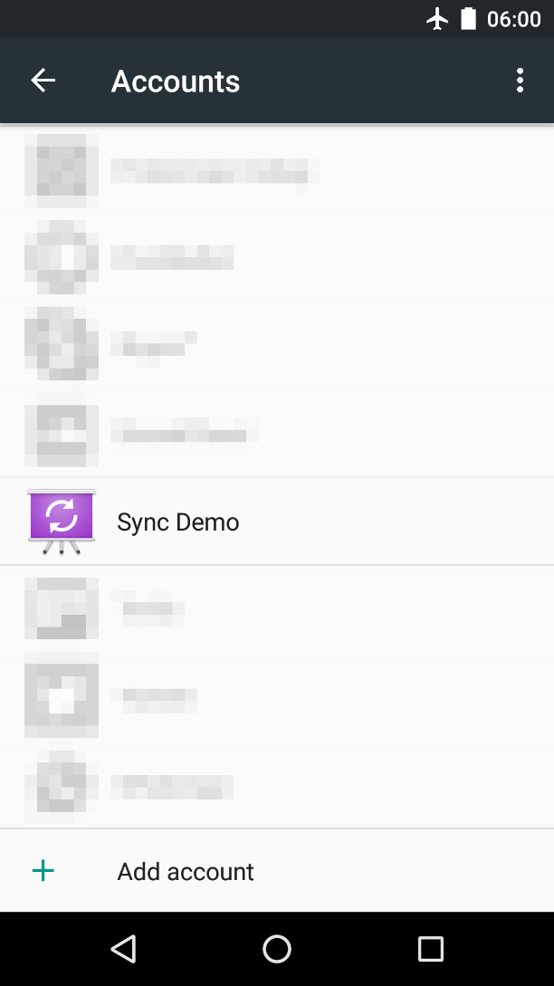
Android Settings

Slide 14
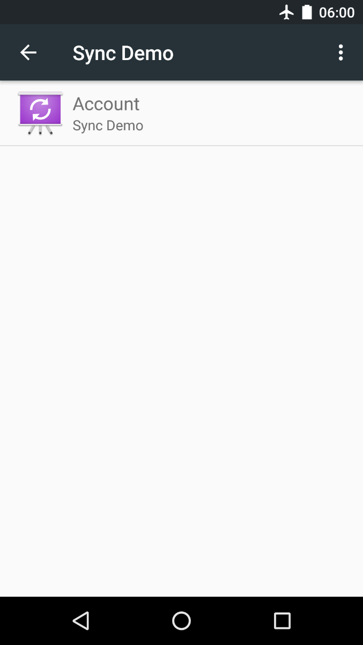
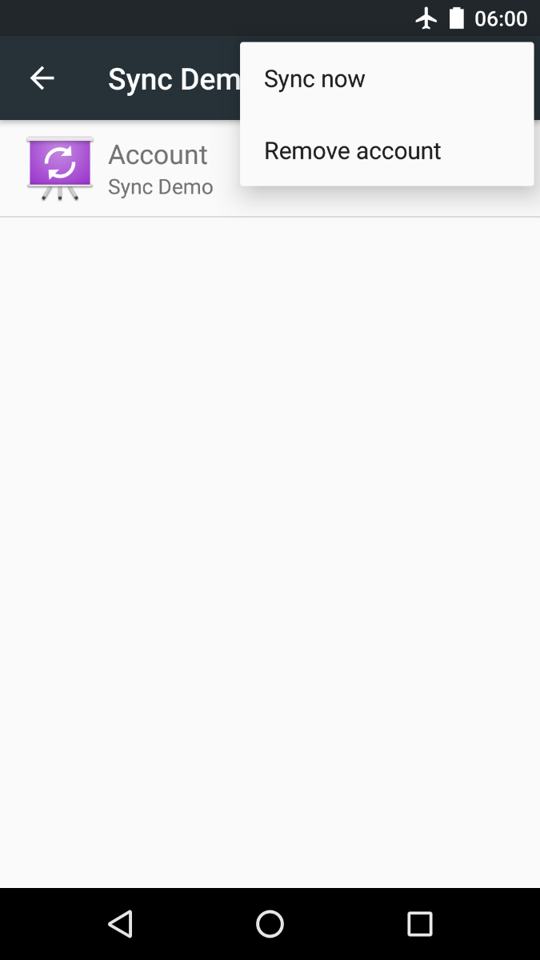
Android Settings

Slide 15
CursorLoader
UI
ContentObserver
ContentResolver.query()
ContentProvider
ContentResolver.insert()
SyncAdapter
Network
Android Framework
Hey, this would be a great moment to synchronize!
ze internet

Slide 16
CursorLoader
UI
ContentObserver
ContentResolver.query()
ContentProvider
ContentResolver.insert()
SyncService
SyncAdapter
Network
Binds to service
Android Framework
ze internet

Slide 17
SyncService
SyncAdapter
SyncAdapter
AndroidManifest.xml
<!-- Required for fetching feed data. --> <uses-permission android:name="android.permission.INTERNET"/>
<!-- Required to enable our SyncAdapter after it's created. --> <uses-permission android:name="android.permission.WRITE_SYNC_SETTINGS"/>
<!-- Required because we're manually creating a new account. --> <uses-permission android:name="android.permission.AUTHENTICATE_ACCOUNTS"/>

Slide 18
AndroidManifest.xml
<service android:name=".sync.SyncService" />

Slide 19
AndroidManifest.xml
<service android:name=".sync.SyncService" >
<intent-filter> <action android:name=" "/> </intent-filter>
<meta-data android:name=" " android:resource=" "/> </service>
<!-- This service implements our SyncAdapter. It needs to be exported, so that the system sync framework can access it. --> <service android:name=".sync.SyncService" android:exported="true">
<intent-filter> <action android:name=" "/> </intent-filter>
<meta-data android:name=" " android:resource=" "/> </service>
<!-- This service implements our SyncAdapter. It needs to be exported, so that the system sync framework can access it. --> <service android:name=".sync.SyncService" android:exported="true"> <!-- This intent filter is required. It allows the system to launch our sync service as needed. --> <intent-filter> <action android:name="android.content.SyncAdapter"/> </intent-filter>
<meta-data android:name=" " android:resource=" "/> </service>
<!-- This service implements our SyncAdapter. It needs to be exported, so that the system sync framework can access it. --> <service android:name=".sync.SyncService" android:exported="true"> <!-- This intent filter is required. It allows the system to launch our sync service as needed. --> <intent-filter> <action android:name="android.content.SyncAdapter"/> </intent-filter> <!-- This points to a required XML file which describes our SyncAdapter. --> <meta-data android:name="android.content.SyncAdapter" android:resource="@xml/syncadapter"/> </service>

Slide 20
SyncService.java
public class SyncService extends Service {
private SyncAdapter mSyncAdapter = null;
/** * Creates {@link SyncAdapter} instance. */ @Override public void onCreate() { super.onCreate(); mSyncAdapter = new SyncAdapter(getApplicationContext(), true); }
…

Slide 21
SyncService.java
…
/** * Return Binder handle for IPC communication with {@link SyncAdapter}. * * <p>New sync requests will be sent directly to the SyncAdapter using this channel. * * @param intent Calling intent * @return Binder handle for {@link SyncAdapter} */ @Override public IBinder onBind(Intent intent) { return mSyncAdapter.getSyncAdapterBinder(); }
}

Slide 22
Launched by the system
Lives as long as the SyncAdapter is running
Allows system to bind to SyncAdapter

Slide 23
res/xml/syncadapter.xml
<sync-adapter xmlns:android="http://schemas.android.com/apk/res/android" android:accountType="com.example.android.basicsyncadapter.account" android:allowParallelSyncs="false" android:contentAuthority="com.example.android.basicsyncadapter" android:isAlwaysSyncable="true" android:supportsUploading="false" android:userVisible="false"/>

Slide 24
SyncAdapter.java
/** * Define a sync adapter for the app.
*
* <p>This class is instantiated in {@link SyncService}, which also binds SyncAdapter to the
* system. SyncAdapter should only be initialized in SyncService, never anywhere else.
*
* <p>Extending AbstractThreadedSyncAdapter ensures that all methods within SyncAdapter
* run on a background thread, so it is safe to perform blocking I/O here.
*
* <p>The system calls onPerformSync() via an RPC call through the IBinder object supplied by
* SyncService.
*/ public class SyncAdapter extends AbstractThreadedSyncAdapter {
…

Slide 25
SyncAdapter.java
/**
* Called by the Android system in response to a request to run the sync adapter. The work
* required to read data from the network, parse it, and store it in the content provider is
* done here.
*
* <p>{@link android.content.AbstractThreadedSyncAdapter} guarantees that this will be called
* on a non-UI thread, so it is safe to perform blocking I/O here.
*
* <p>The syncResult argument allows you to pass information back to the method that triggered
* the sync.
*/
@Override public void onPerformSync(Account account, Bundle extras, String authority, ContentProviderClient provider, SyncResult syncResult) {}

Slide 26
Do I need a ContentProvider?
Yes…
<sync-adapter xmlns:android="http://schemas.android.com/apk/res/android" android:accountType="com.example.android.basicsyncadapter.account" android:allowParallelSyncs="false" android:contentAuthority="com.example.android.basicsyncadapter" android:isAlwaysSyncable="true" android:supportsUploading="false" android:userVisible="false"/>
<provider android:name=".provider.FeedProvider" android:authorities="com.example.android.basicsyncadapter" android:exported="false"/>
<sync-adapter
android:accountType="com.example.android.basicsyncadapter.account"
android:contentAuthority="com.example.android.basicsyncadapter"
/>
<provider
android:authorities="com.example.android.basicsyncadapter" />

Slide 27
Do I need a ContentProvider?
Yes… but it doesn’t need to do anything.
public class DummyProvider extends ContentProvider { @Override public boolean onCreate() { return false; } @Override public int delete(...) { return 0; } @Override public String getType(...) { return null; } @Override public Uri insert(...) { return null; } @Override public Cursor query(...) { return null; } @Override public int update(...) { return 0; }
}

Slide 28
Significance of accountType
<sync-adapter xmlns:android="http://schemas.android.com/apk/res/android" android:accountType="com.example.android.basicsyncadapter.account" android:allowParallelSyncs="false" android:contentAuthority="com.example.android.basicsyncadapter" android:isAlwaysSyncable="true" android:supportsUploading="false" android:userVisible="false"/>
…
return new Account(accountName, ACCOUNT_TYPE);
<sync-adapter
android:accountType="com.example.android.basicsyncadapter.account"
/>
…
return new Account(accountName, ACCOUNT_TYPE);

Slide 29
Beware of the account name
It is used to identify the account
Usually a username or email
It should not be localized!
If the user switches locale, we would not be able to locate the old account, and may erroneously register multiple accounts

Slide 30
Recap
SyncAdapters can be used to:
Fetch background data for an app
Execute your data transfer code
at configurable intervals
while efficiently using battery and other system resources

Slide 31
Recap
Elements of a sync adapter:
Create a class extending AbstractThreadedSyncAdapter.
Create a bound Service which the OS uses to initiate a sync.
Define the sync adapter properties in an XML resource file.
Declare the bound Service in the app manifest.

Slide 32
https://github.com/googlesamples/android-BasicSyncAdapter
https://developer.android.com/training/sync-adapters/creating-sync-adapter.html
https://developer.android.com/training/sync-adapters/index.html
http://blog.udinic.com/2013/07/24/write-your-own-android-sync-adapter/
https://software.intel.com/en-us/android/articles/handling-offline-capability-and-data-sync-in-an-android-app-part-2

Slide 33
SyncAdapters can be used to:
fetch background data for an app.
execute your data transfer code at configurable intervals, while efficiently using battery and other system resources
Elements of a sync adapter:
Creates a sync adapter class.
Creates a bound Service which the OS uses to initiate a sync.
Defines the sync adapter properties in an XML resource file.
Declares the bound Service in the app manifest.

Slide 34
Extend the base sync adapter class AbstractThreadedSyncAdapter
/** * Handle the transfer of data between a server and an * app, using the Android sync adapter framework. */ public class SyncAdapter extends AbstractThreadedSyncAdapter {
/** * Set up the sync adapter */ public SyncAdapter(Context context, boolean autoInitialize) {
super(context, autoInitialize);
}
public SyncAdapter( Context context, boolean autoInitialize, boolean allowParallelSyncs) { super(context, autoInitialize, allowParallelSyncs);
}
}

Slide 35
onPerformSync()
Sync adapter framework invokes your SyncAdapter
Calls onPerformSync()
Account
Bundle
Authority
ContentProviderClient
SyncResult

Slide 36
onPerformSync()
/* * Specify the code you want to run in the sync adapter. The entire * sync adapter runs in a background thread, so you don't have to set * up your own background processing. */ @Override public void onPerformSync( Account account, Bundle extras, String authority, ContentProviderClient provider, SyncResult syncResult) { /* * Put the data transfer code here. */ ... }

